Slide 1

Research Project Presentation
Optimizing Healthcare Quality Through
Data-Driven Efficiency :
Analysis Of Elective Hip Replacement
Surgeries in New York
Submitted by :
Bhavitha Redrouthu

Slide 2
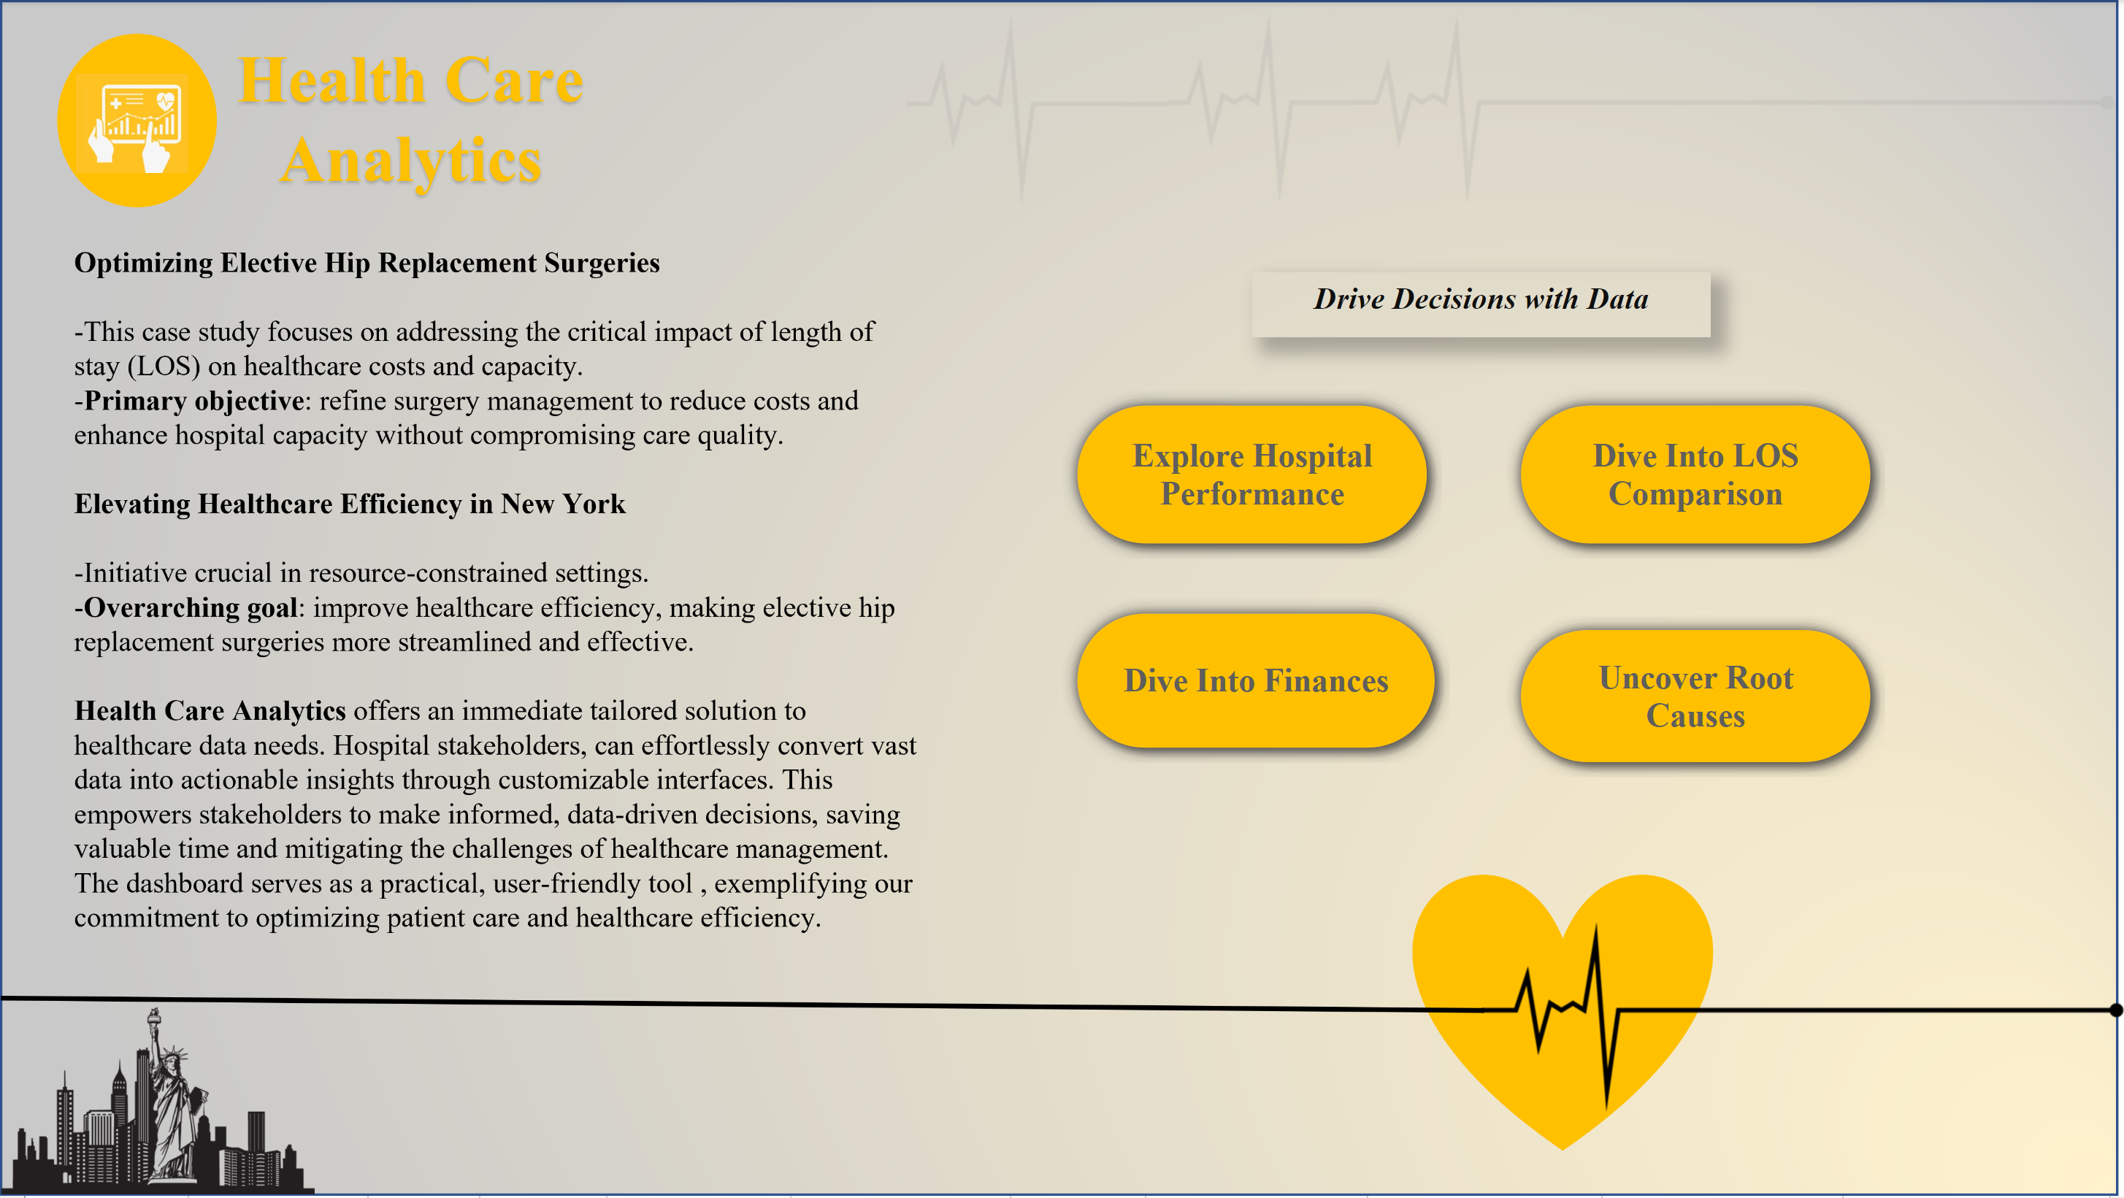
Home Dashboard
These buttons facilitate navigation between various dashboards.

Slide 3
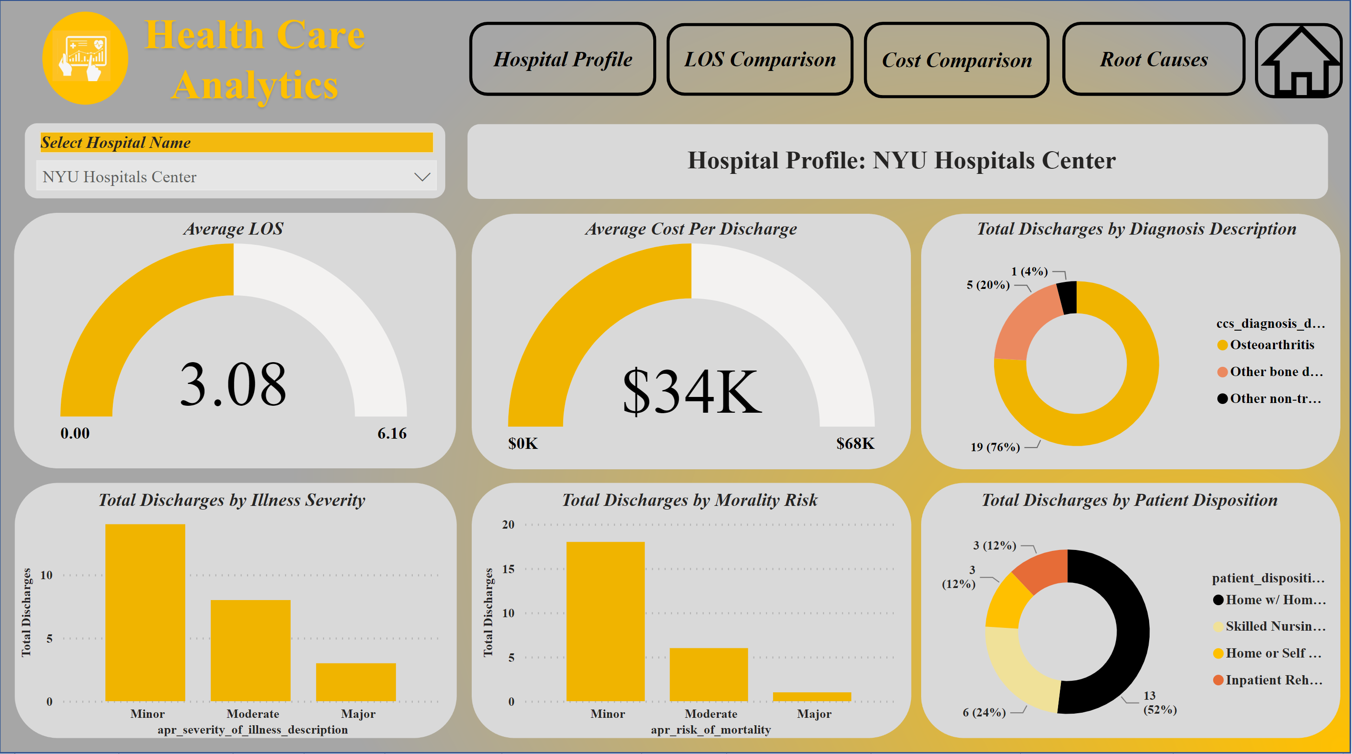
Dashboard 1 : Hospital Performance
Single Select Slicer
Average LOS:
-Gauge chart summarizes NYU Hospitals Center's average length of stay, assisting healthcare professionals in comparing it with the state’s average los.
Severity Spectrum:
NYU Hospitals: Can use Severity Bar Chart for efficient resource planning, may be by planning to allocate more resources to major illness cases.
These donut charts depict discharge variations post-surgery and by diagnosis, providing valuable insights for NYU Hospitals to enhance patient care strategies.
Average Discharge Cost: Gauge chart visualizes NYU Hospitals Center's discharge costs relative to the state’s discharge cost average.
Risk Assessment : The mortality risk bar chart reveals that NYU Hospitals experience lower discharge rates with major risks, enabling informed actions.

Slide 4
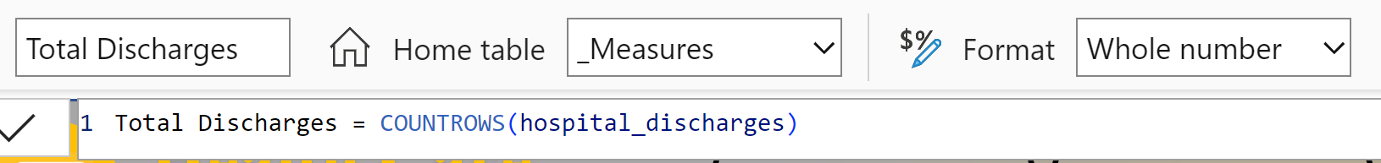


Hospital Performance Dashboard
Key Features
Efficiency Focus:
-Average Length Of Stay (LOS) is a measure created
to assesses patient care efficiency.
Key Metric: Total Discharge in Diagnostic and Post-Surgery Patterns
Total Discharge is another useful measure created & used in 2 donut charts and 2 column charts
-To identify Diagnostic Patterns
-To identify Post Surgery Patterns
-To identify Total Discharges Variability across Severity and Mortality Risk respectively.
Financial Insight:
-Average Cost Per Discharge is a measure created for financial
optimization.

Slide 5
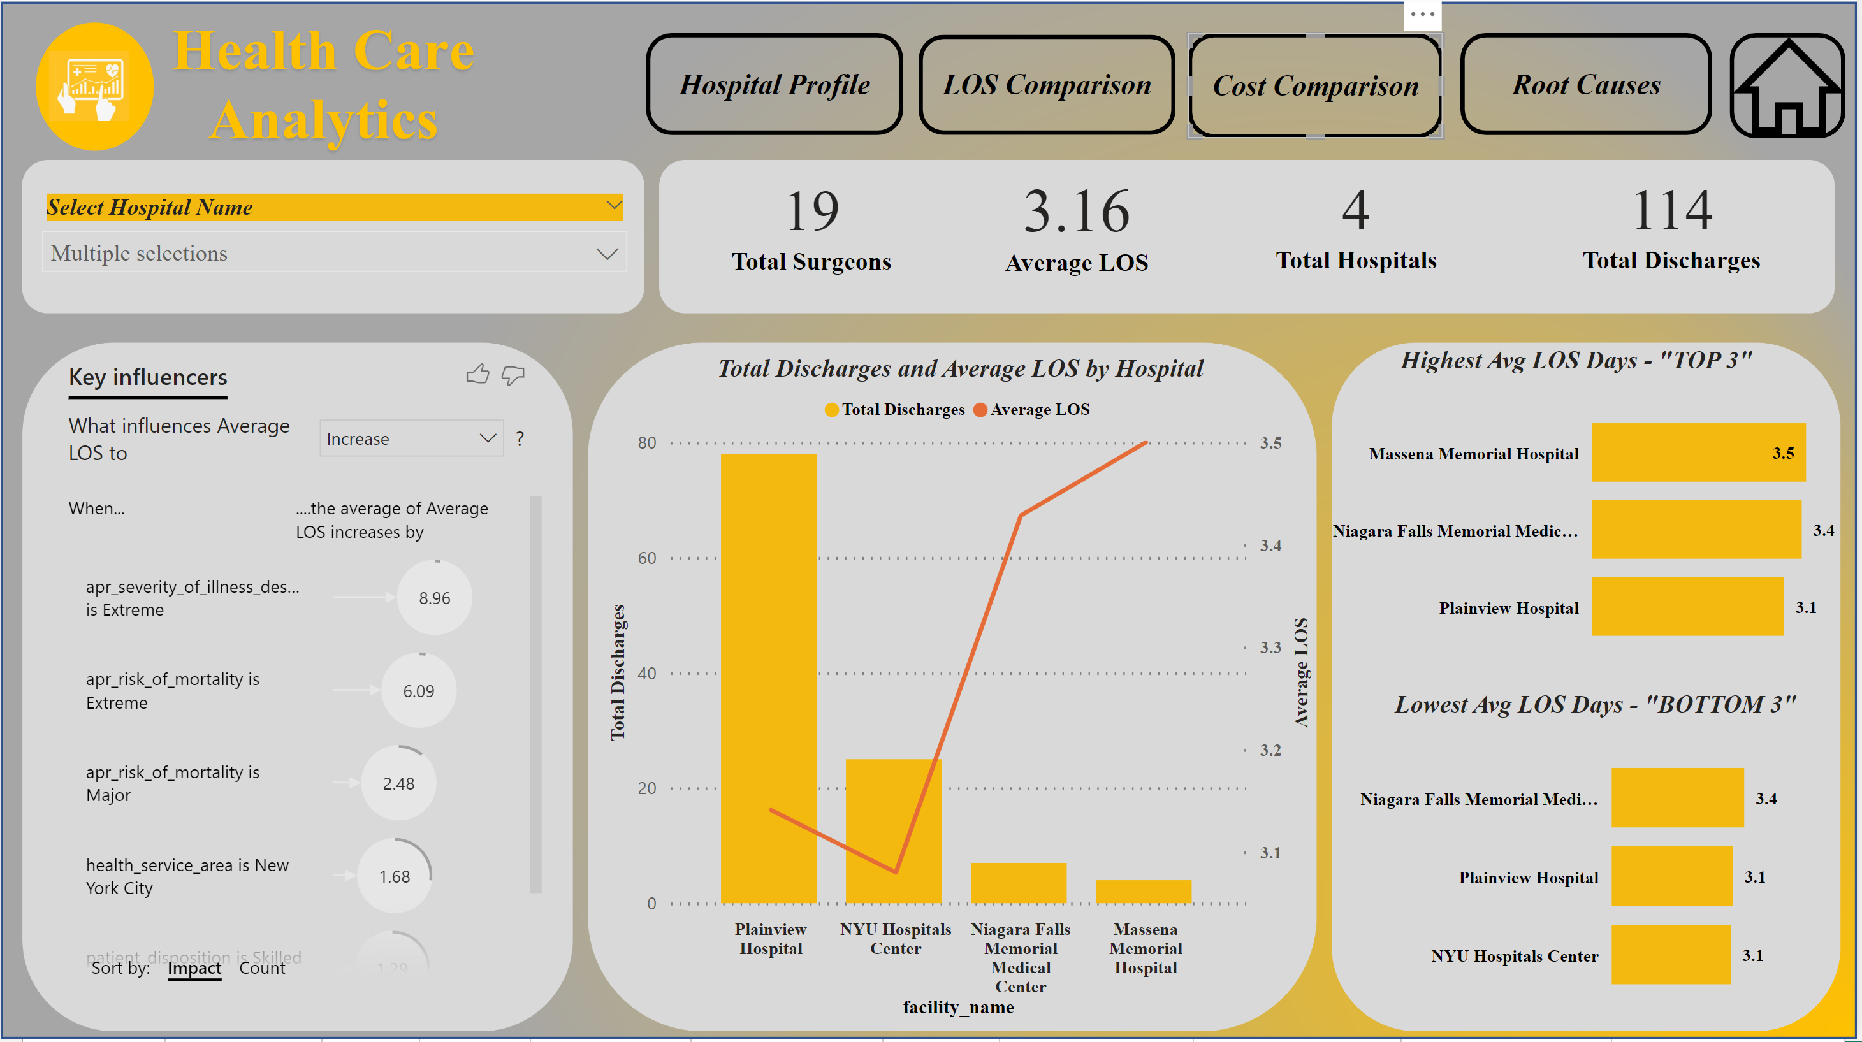
Dashboard 2 : LOS Comparison
Multi-Select Slicer
Key Metrics
-Key influencers visualization highlights factors contributing to increased average length of stay for selected hospitals.
-Key influencers reveals factors affecting prolonged length of stay, aiding strategic decisions and interventions for enhanced patient care efficiency.
-These charts identify top 3 highest and bottom 3 lowest avg LOS hospitals.
-Facilitates pinpointing hospitals with higher stays
-Recognizes hospitals excelling in lower stays. Understanding shorter stays of these hospitals might help
in planning resources effectively.
-Clear patterns emerge: Plainview shows higher discharges / lower LOS, and Massens Memorial Hospital shows lower discharges / higher LOS.
-This information guides healthcare administrators in optimizing resource allocation and patient care strategies."

Slide 6
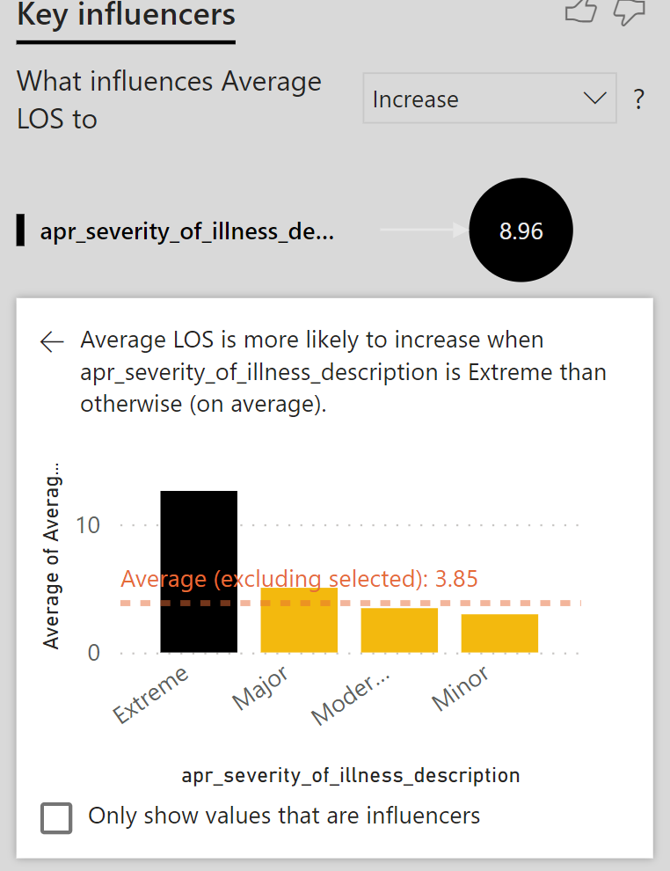
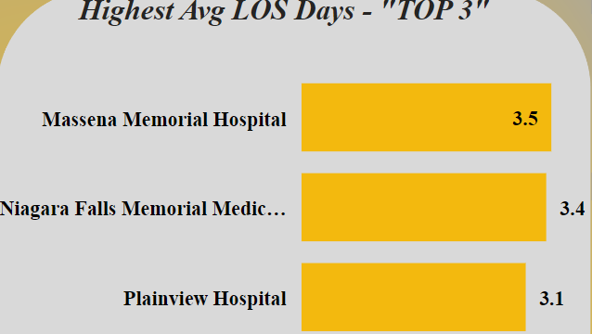
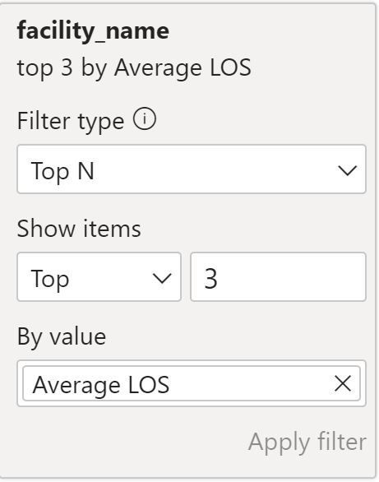
LOS Comparison Dashboard
Key Features
Clustered Bar Chart Significance:
-Filter and display the top three hospitals with the highest avg LOS.
-Utilize the "Top N" filter to pinpoint hospitals with significant LOS implications.
-Usefulness: Facilitates hospital comparison, identifying outliers, enabling hospital administrators to strategically allocate resources.
Key Influencer Visualization : “Detail Enhancement"
-The Key Influencer visualization
is a robust and detailed focal
point, offering users a
comprehensive understanding.
-Upon clicking the impact,
additional details are generated,
enhancing user comprehension

Slide 7
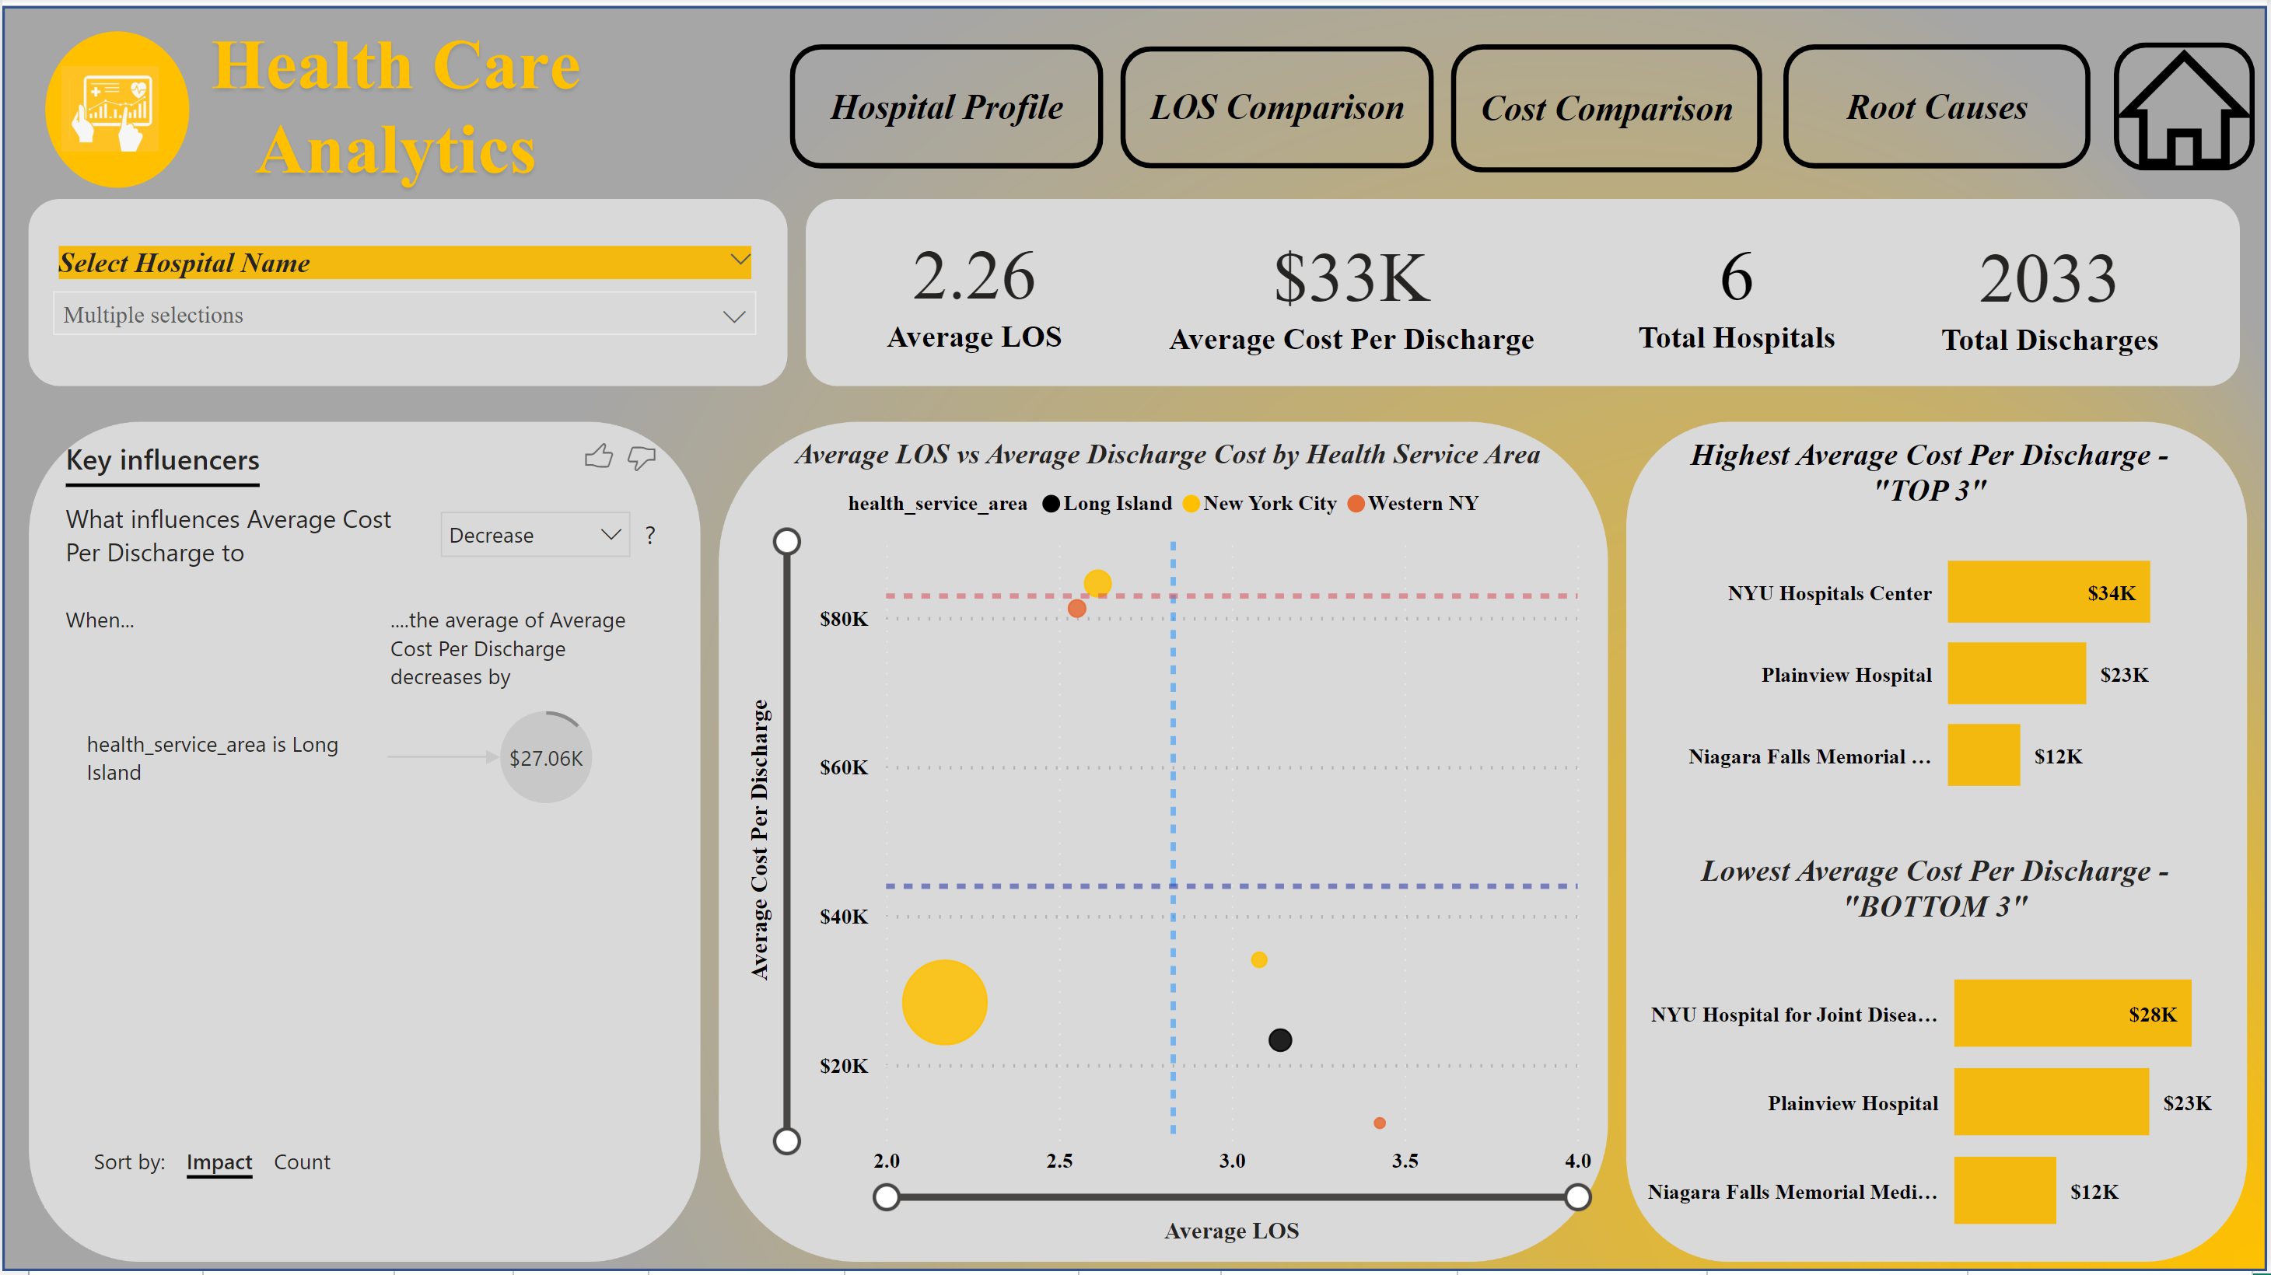
Dashboard 3 : Cost Comparison
Multi-Select Slicer
Key Metrics
Key influencers visualization highlights factors contributing to increased average cost per discharge for selected hospitals.
Key influencers reveals factors affecting high costs, to identify cost drivers, and aiding strategic decisions
-These charts identify top 3 highest and bottom 3 lowest avg cost per discharge.
-Facilitates pinpointing hospitals contributing most to discharge costs.
-Recognizes hospitals excelling in cost-effective discharges.
Among the selected five hospitals, it is evident that New York City's health service area incurs higher costs and longer length of stay.
-Legend (Health Service Area): Adds another layer of analysis by categorizing hospitals based on health service areas.
-Size (Total Discharges Count): Provides insight into the volume of discharges for each hospital

Slide 8
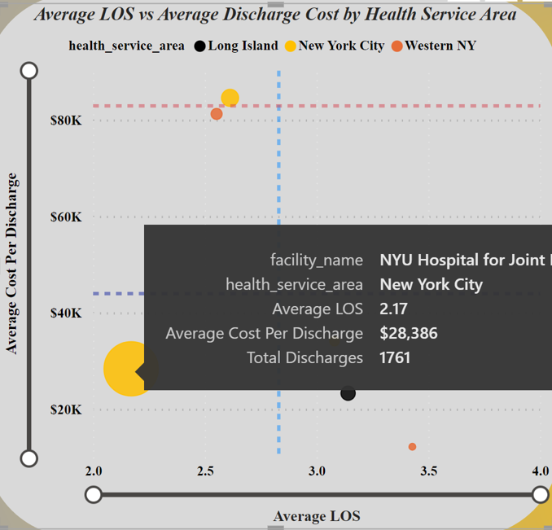
Cost Comparsion Dashboard
Key Features
Scatter Chart Significance
Purpose: Visualize the correlation between average length of stay, average cost per discharge, and total discharges.
Function:
-Assess the relationship between the average length of stay and discharge cost.
-Legend (Health Service Area): Adds another layer of analysis by categorizing hospitals based on health service areas.
-Size (Total Discharges Count): Provides insight into the total number of discharges for each hospital.

Slide 9
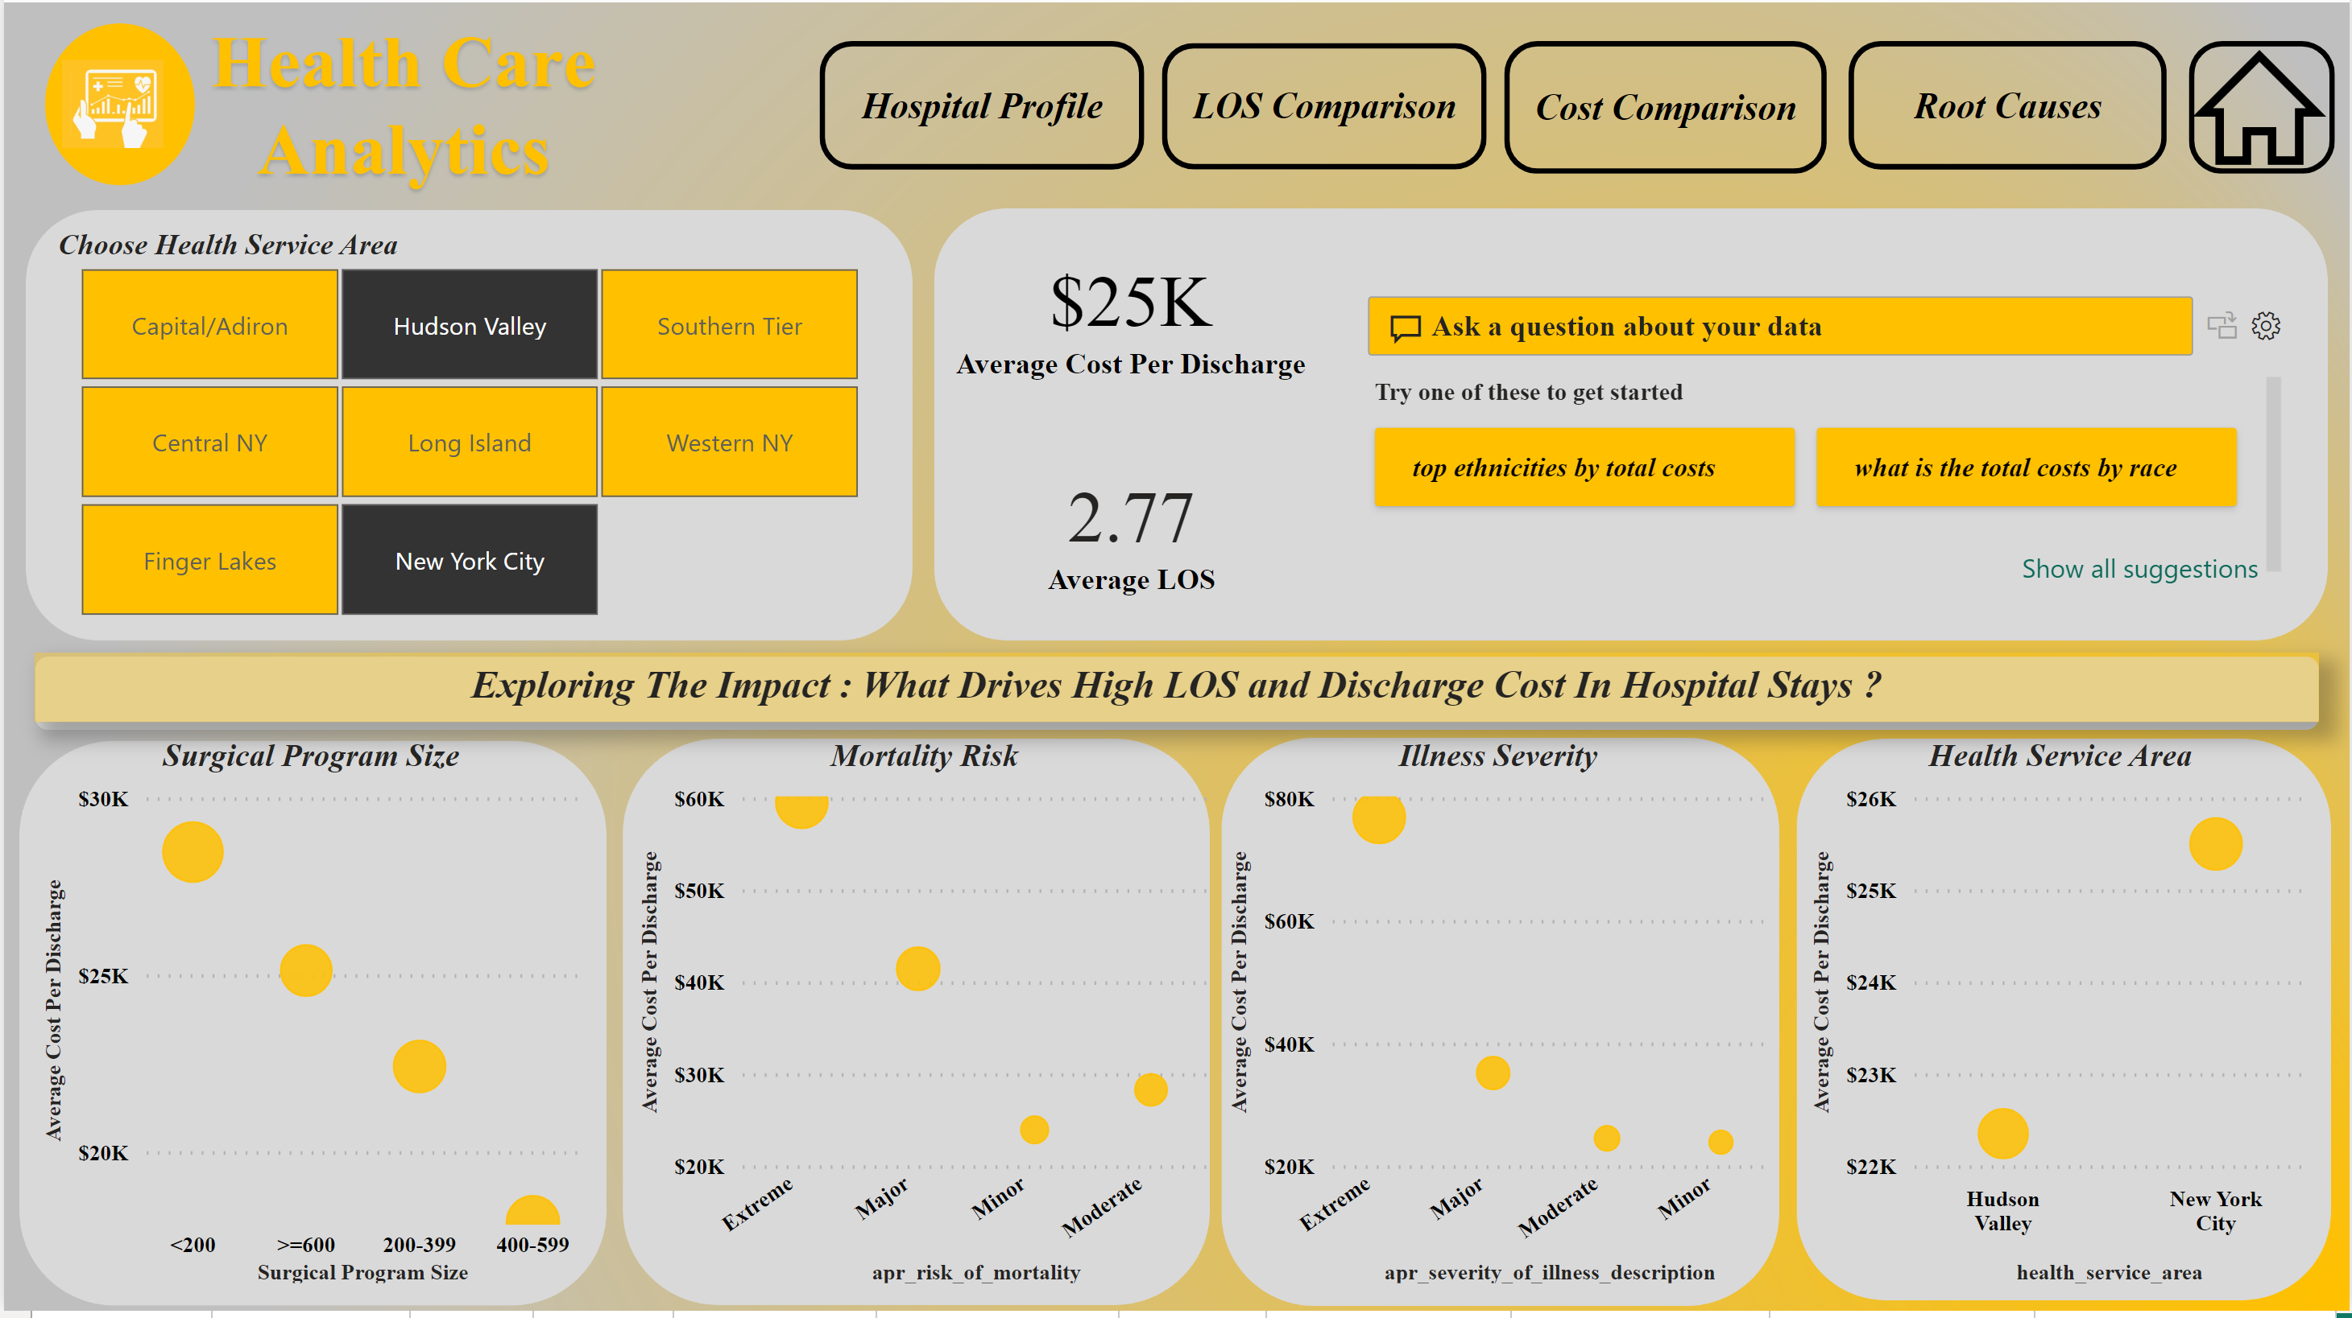
Dashboard 4: Root Causes
Multi-Select Slicer
Key Metrics
The above four visualization contribute to key insights:
-Smaller surgical programs contribute to longer stays, elevating costs.
-Patients with extreme mortality risk and illness severity drive up both costs and duration of stays.
-The New York City health service area is a key factor in driving up costs and duration of stays.
-Useful For : Holistic Understanding of Cost and Efficiency, Identification Of Root Cause, Data-Driven Support

Slide 10
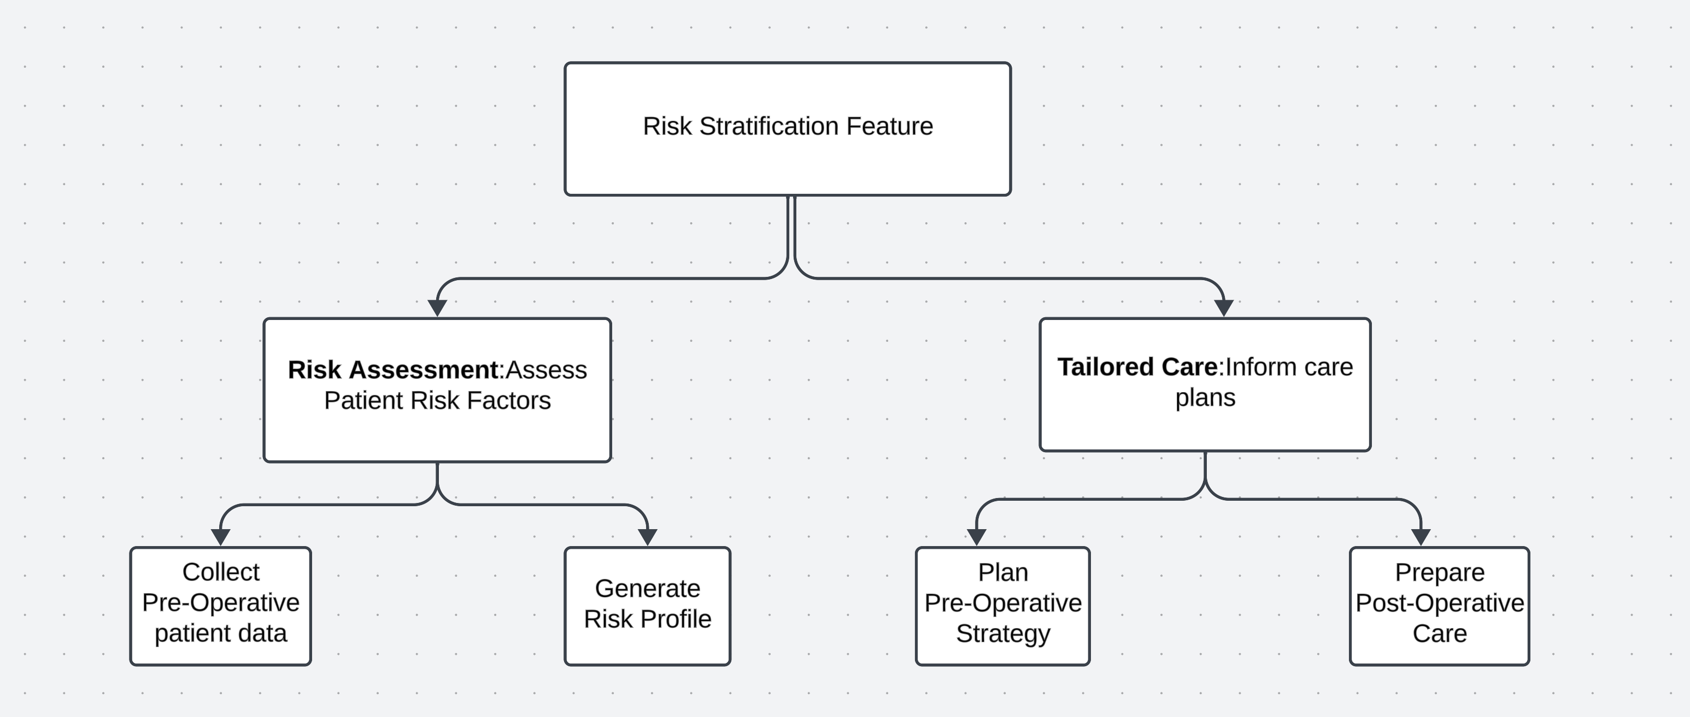
Future Development
Business Solution For The Project : OptiCare InsightHub
Rationale Behind This Naming :
OptiCare : Optimization Focus & Patient Centric Approach
InsightHub: Insightful Analysis
The combination of OptiCare InsightHub is a holistic solution not only address current challenges but also provides a platform for continuous improvement and informed decision making in healthcare management.
Features :
Risk Stratification Feature:
-Assess Patient Risks For Elective Hip Replacement Surgeries.
-Guides Pre and Post Operative Care Decisions.
-Empowers providers for tailored care.
-Enhances resource management for effective patient care.

Slide 11
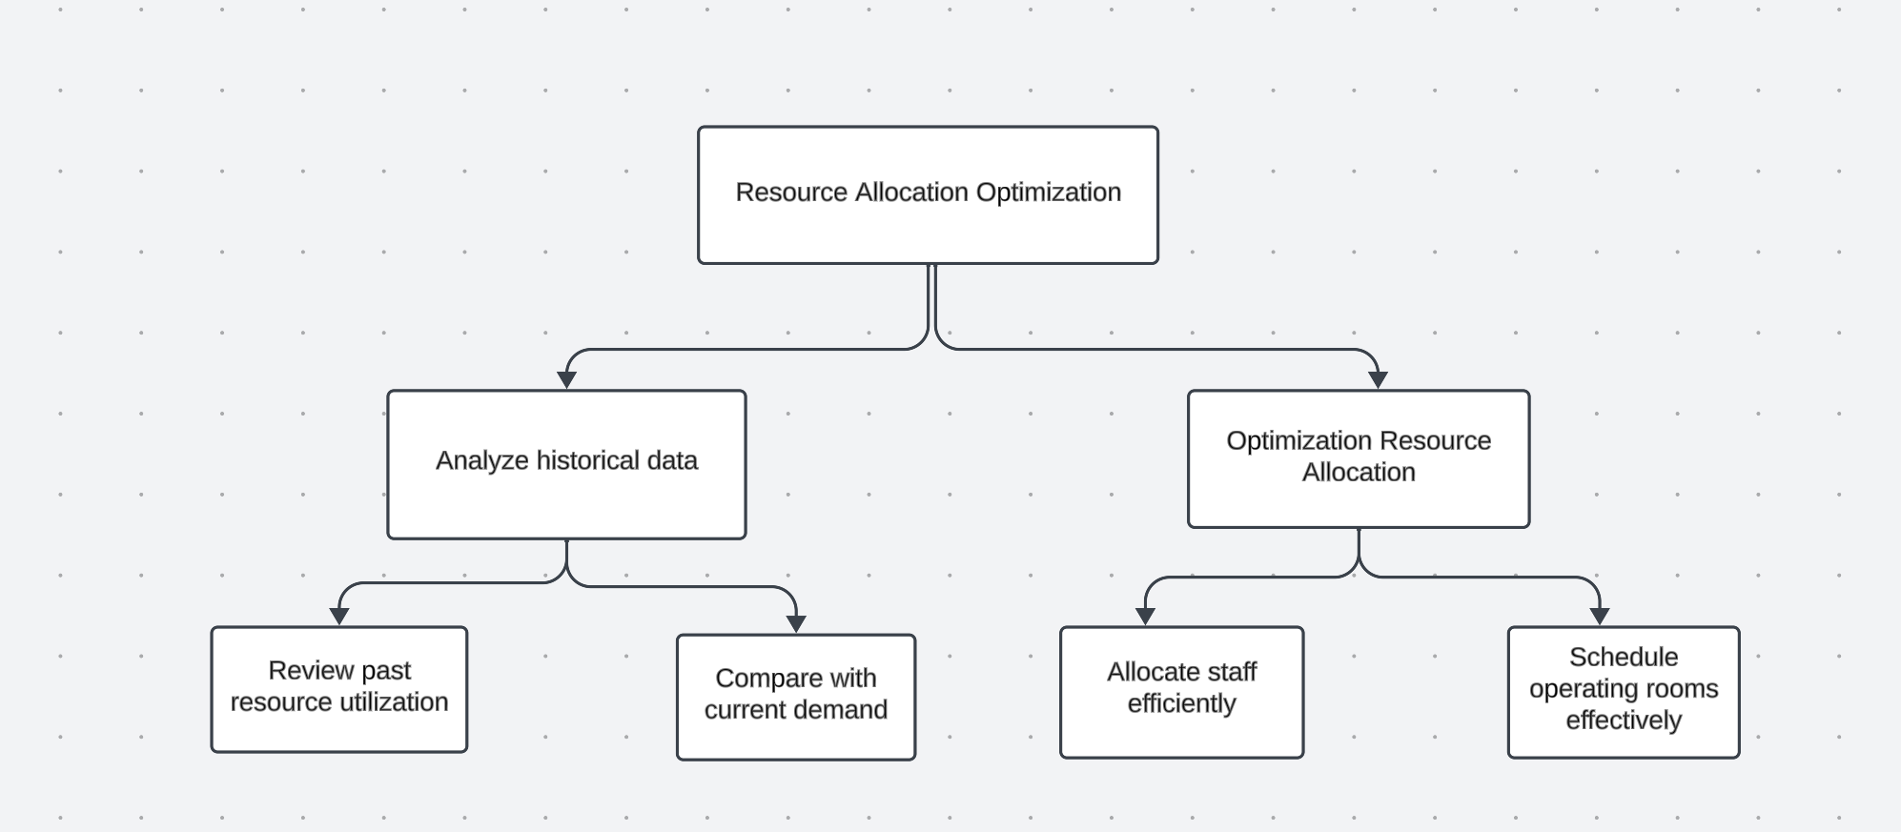
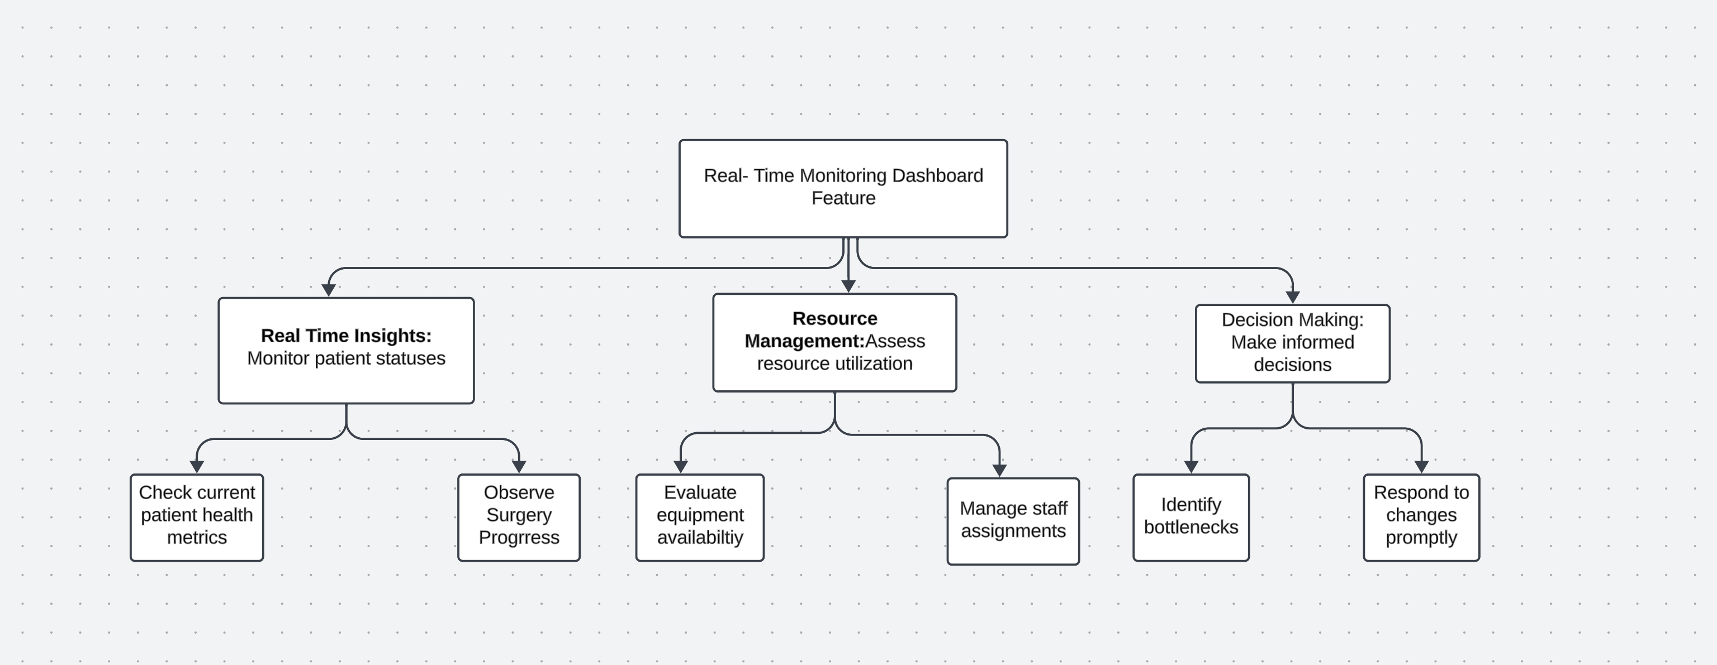
Features :
Resource Allocation Optimization:
-Module Functionality : Analyze historical resource use and
Current demand for efficient allocation.
-Impact On Efficiency:Minimizes delays, cut costs, efficiently allocating staff, rooms, equipment.
-Smoother Patient Flow
-Healthcare Delivery Improvement
Real Time Monitoring Dashboard Feature:
-Gives Instant Insights
-Improved Workflow

Slide 12
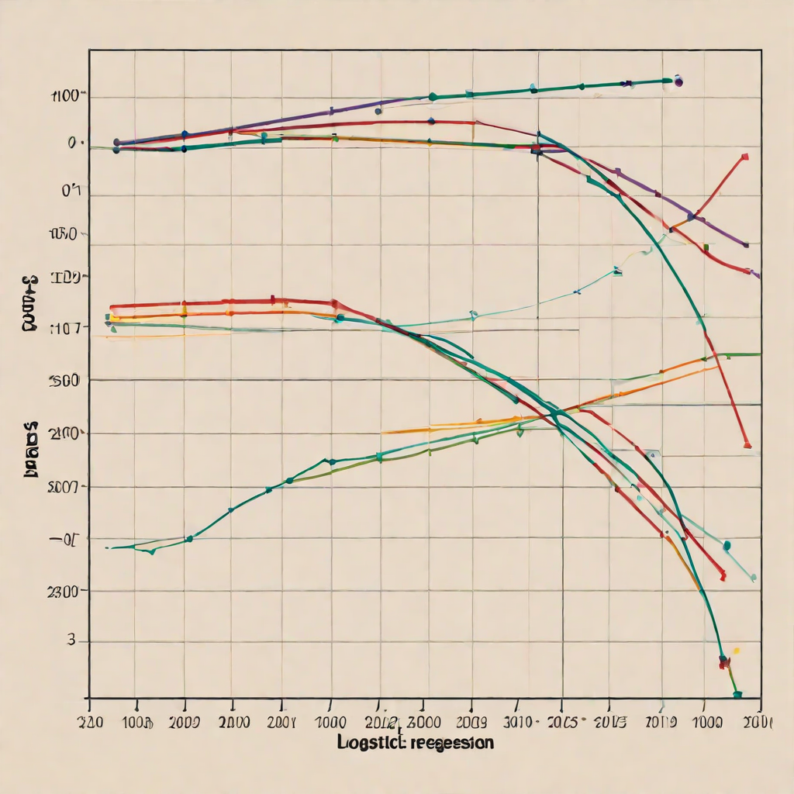

OptiCare InsightHub: Integrating Specific AI Technologies for Future Development
Incorporating AI Technology into the Risk Stratification Feature
Machine Learning Model: Supervised learning model, such as Logistic Regression or Random Forest or Bidirectional Encoder Representations from Transformers (BERT)
Machine Learning Model : Logistic Regression
Benefits:
-Provides a quantitative assessment of risk
-Allows for personalized treatment planning
-Improves patient outcomes by identifying high-risk patients and implementing preventative measures
Eg: In the elective hip replacement risk stratification,
logistic regression identifies high-risk patients
by analyzing factors like age and medical history,
predicting post-surgery complication probabilities.

Slide 13

OptiCare InsightHub: Integrating Specific AI Technologies for Future Development
2.Incorporating AI Technology into the Resource Allocation Optimization Feature
Machine Learning Model: Reinforcement Learning model, such as
Proximal Policy Optimization (PPO)
Example Use Case :
Imagine a hospital with a dynamic surgery schedule for elective hip replacements. By incorporating a Proximal Policy Optimization (PPO) model, the AI-driven system continually learns from historical surgery schedules, staff availability, and resource utilization. In a real-time scenario, the PPO model provides recommendations on optimal resource allocation, considering variables like staff availability and operating room utilization. For instance, if the model identifies a potential bottleneck in the schedule, it may suggest adjustments to prevent delays and streamline the process
Benefits of Incorporating AI:
Minimized surgery delays.
Reduced costs and improved operational efficiency.
Continuous learning for adaptive resource optimization.
Smoother patient flow and enhanced healthcare delivery.

